Slide 1

Work Portfolio with JPMorgan chase & co

Slide 2

Company overview JPMorgan chase & co. Is an American multinational finance company headquartered in New York city and incorporated in Delaware. It is the largest bank in the united states and the world's largest bank by market capitalization as of 2023

Slide 3

Customer Requirement Project-1 (Customer Support)
Customer required a dashboard that provides a comprehensive analysis of customer support tickets across various regions.
It includes to visualizes key metrics such as ticket status, ticket priority, customer demographics, and purchase behaviors based on results Management identify trends, understand customer needs, and improve service efficiency.

Slide 4
MYROLE in Project- Team Lead and Developer
At Chase, As a Leading a team and we empower to creating a Business Intelligence (BI) dashboards for banking support and involves designing a visual representation of key metrics and data related to support operations. The dashboard should provide insights into performance, efficiency, and customer satisfaction to aid decision-making and operational improvements.

Slide 5
Problem Statement and Data Source
Market gap: Focus on fundamental issues where traditional banking services may fall short. Here are some core areas where gaps commonly exist
Example: Response Time, Accessibility, Complexity of Service, Consistency Across Channels, Problem Resolution, Training and Knowledge, Feedback Mechanisms and Customer Empowerment
Dataset Source: Customer Support Ticket Dataset from Twitter and SQL server
Description: The dataset includes customer support tickets for various tech products, covering hardware issues, software bugs, network problems, account access, data loss, and other support topics. It provides details about the customer, the product purchased, the ticket type, the ticket channel, ticket status, and other relevant information.
Dashboard Frequency: Daily, Weekly, Fortnight, Monthly, Quarterly and Annually

Slide 6
Brief Data Processing Procedures in Project
1. Data Cleaning:
- Handle Missing Values: Missing values in critical columns were addressed by either imputing them with appropriate values or excluding those records.
2. Data Transformation:
- Date Parsing: Converted the Date of Purchase column to datetime format.
- Creating Age Bins: Customer ages were categorized into bins to facilitate demographic analysis.
3. Calculated Fields:
- Created calculated fields in Tableau for age bins, ticket counts and other necessary aggregations by using LOD Expressions

Slide 7
Detailed Description of the Dashboard's Features and Functions
Features and Functions:
Dynamic Filtering: Users can filter data by date range, ticket status, priority level, and customer demographics to focus on specific subsets of data.
Interactive Tooltips: Hovering over data points displays additional information, providing more context without cluttering the visualizations.
Drill-downs: Click on segments of charts to drill down into more detailed views or related data.
Small Multiples: Visualizations like the distribution of ticket types by age group are organized into small multiples for easier comparison across categories.
How to Use the Dashboard:
Filters: Use the filter options on the right-hand side to adjust the data displayed. Filters include date range selectors, drop-down menus for ticket status, and sliders for age ranges.
Interactivity: Click on chart segments to highlight related data across other visualizations. Use tooltips for more detailed information on hover.
Reset: A "Reset Filters" button allows you to clear all filters and return to the default view.

Slide 8

Charts Created
Ticket Statu Disctribution
Priority Level Distribution
Ticket Raised By Age Group
Distributed of Tickets types by Age
Top Tickets created across Gender
Customer Support Ticket Trend Over Time
Category wise Ticket
Ticket Type by Segmenatation
Average Customer Satisfaction Score (CSAT)
Top Tickets created by Group

Slide 9
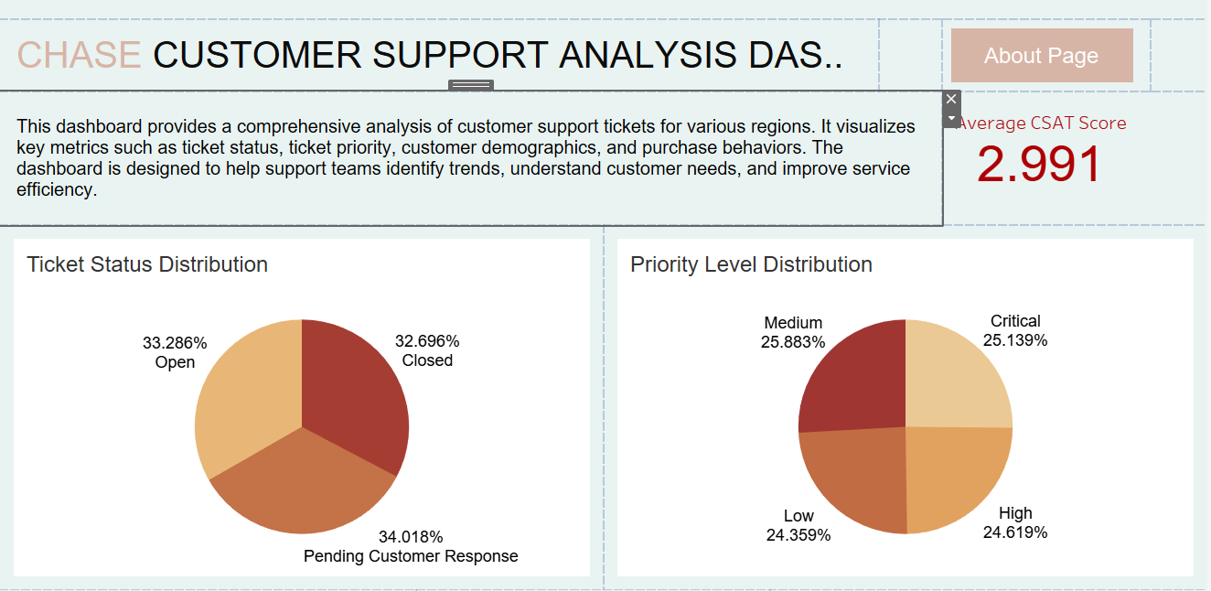
Dashboard Images-1:

Slide 10
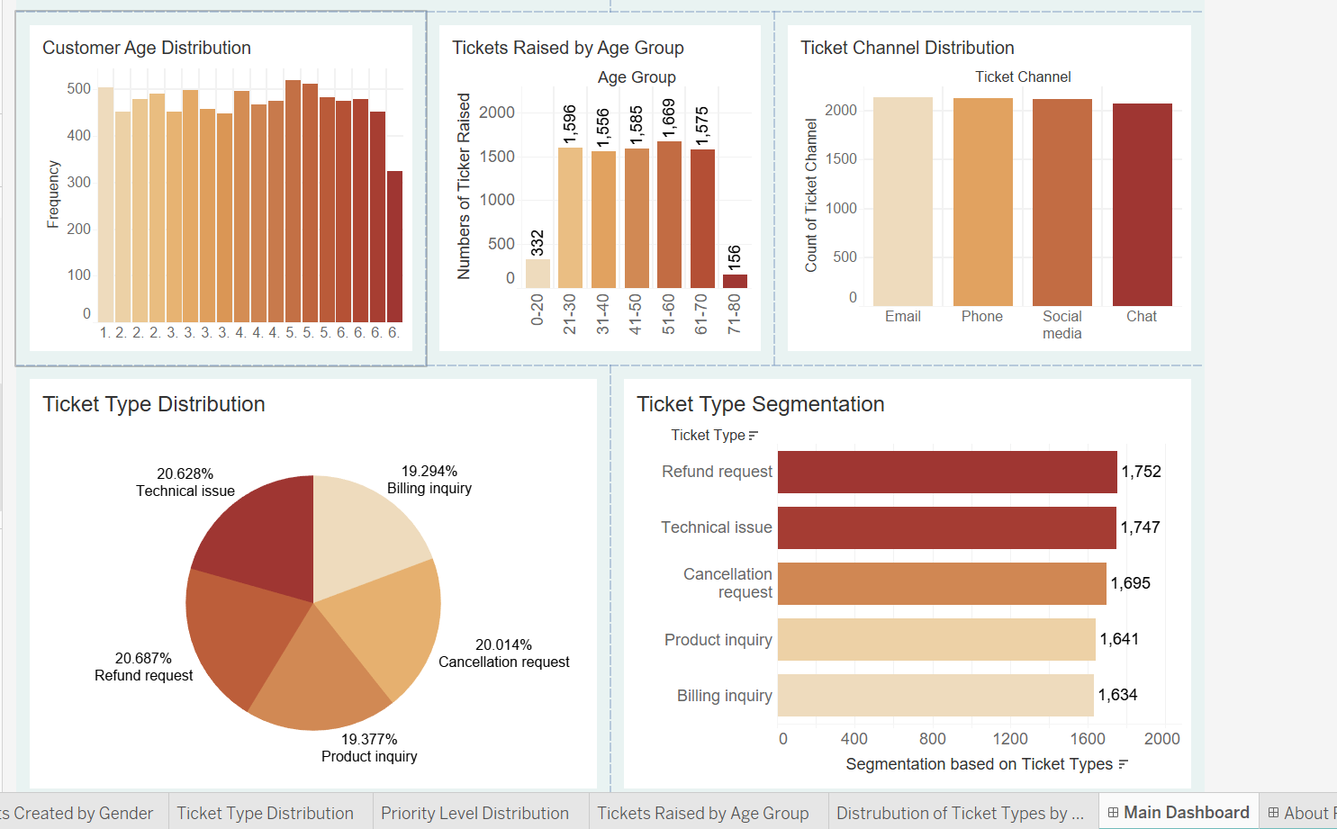
Dashboard Images-2:

Slide 11
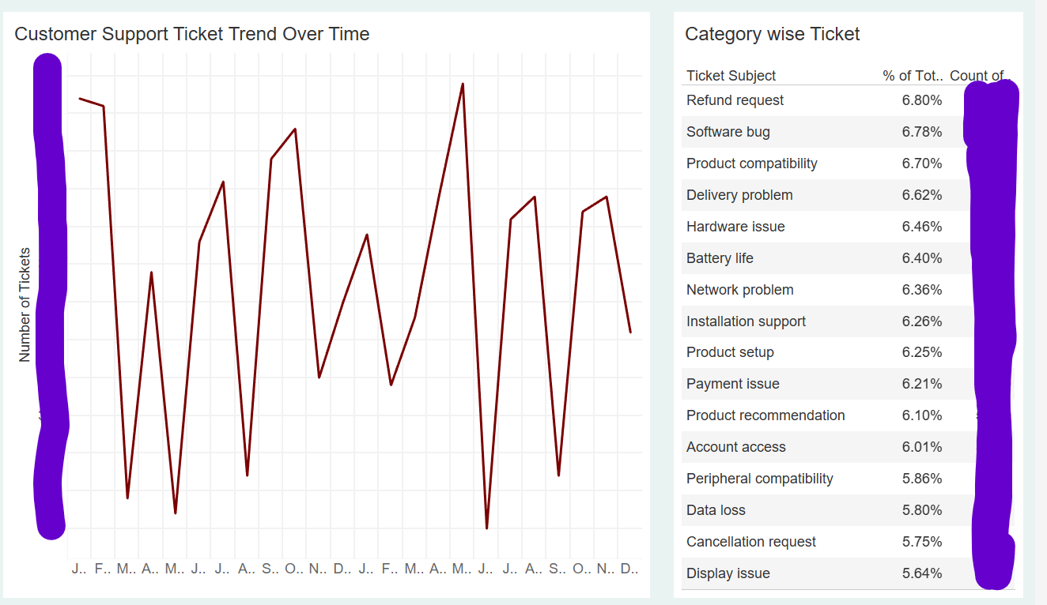
Dashboard Images-3:

Slide 12
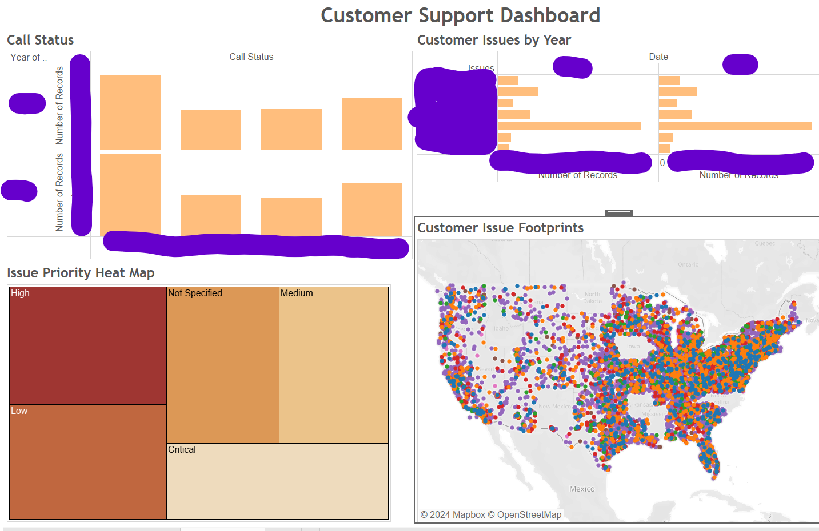
Dashboard Images-4:

Slide 13
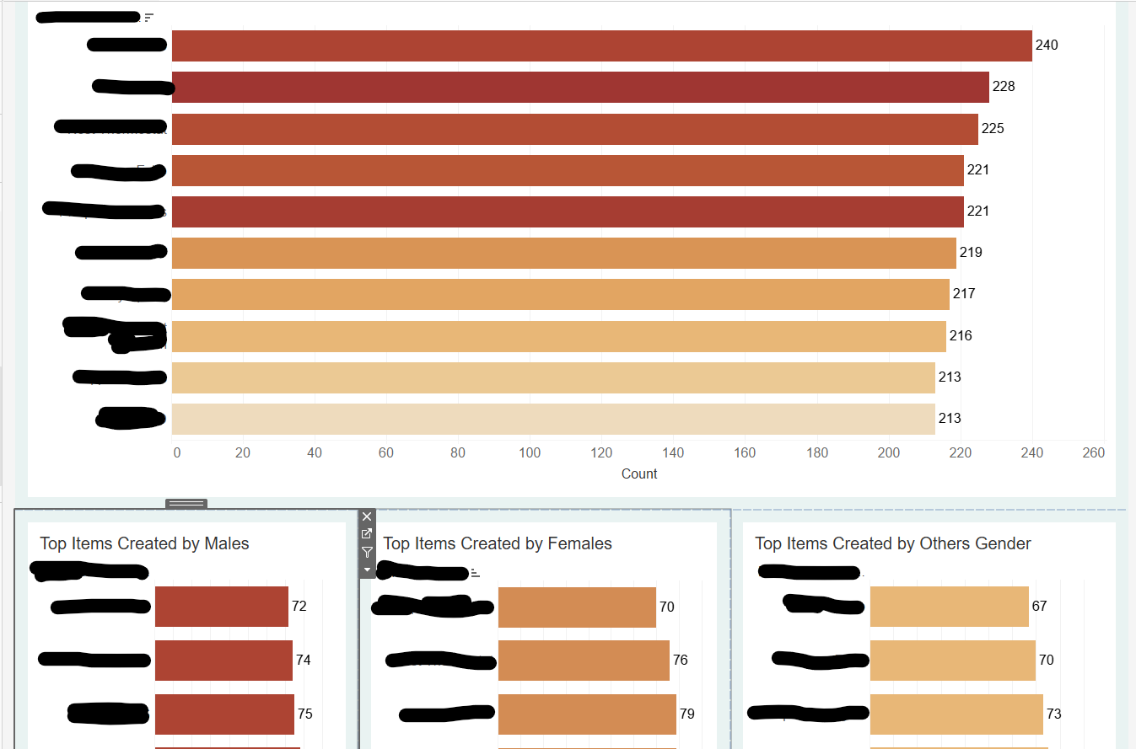
Dashboard Images-5:

Slide 14
Dashboard Solutions Customer Review
Dashboard Solutions Provided:
Customer Inquiry Management
Real-Time Support Metrics
Agent Performance Analytics
Customer Interaction Channels
Compliance and Security
Customer Feedback and Surveys
Customer Feedback:
These solution help streamline customer support operations, improve service quality, and enhance overall customer satisfaction.

Slide 15
Customer Requirement Project-2 (Investment Banking)
Customer required a dashboard that provides a comprehensive analysis of customer support tickets across various regions.
It includes to visualizes key metrics such as ticket status, ticket priority, customer demographics, and purchase behaviors based on results Management identify trends, understand customer needs, and improve service efficiency.

Slide 16
MYROLE in Project- Team Lead and Developer
At Chase, As a Leading a team and we authorize to Creating a Business Intelligence (BI) dashboards for Investment banking that involves designing a visual representation of key metrics in Investment Banking operations. The dashboard solutions provide a comprehensive view of mutual fund performance, investor behavior, market trends, and regulatory compliance, enabling users to make informed decisions and manage mutual fund investments effectively.

Slide 17
Problem Statement and Data Source
Problem Statement: Design a user-friendly and effective dashboard for mutual fund investors that provides real-time insights, performance metrics, and personalized recommendations, while addressing issues related to data accuracy, user experience, and integration with various data sources.
Dataset Source: Datasets received from SAP HANA, SQL server and Oracle and CSV files
Description: This dataset includes financial analysts, investors, and portfolio managers to make informed decisions and perform detailed analysis on mutual funds. It provides Information about the mutual fund’s investment strategy, risks, and fees as outlined in the fund’s prospectus and detailed historical performance data over various time periods, Fund ID, Fund Name, Fund Type, Inception Date, NAV and relevant information.
Dashboard Frequency: Weekly, Monthly, Quarterly and Annually

Slide 18
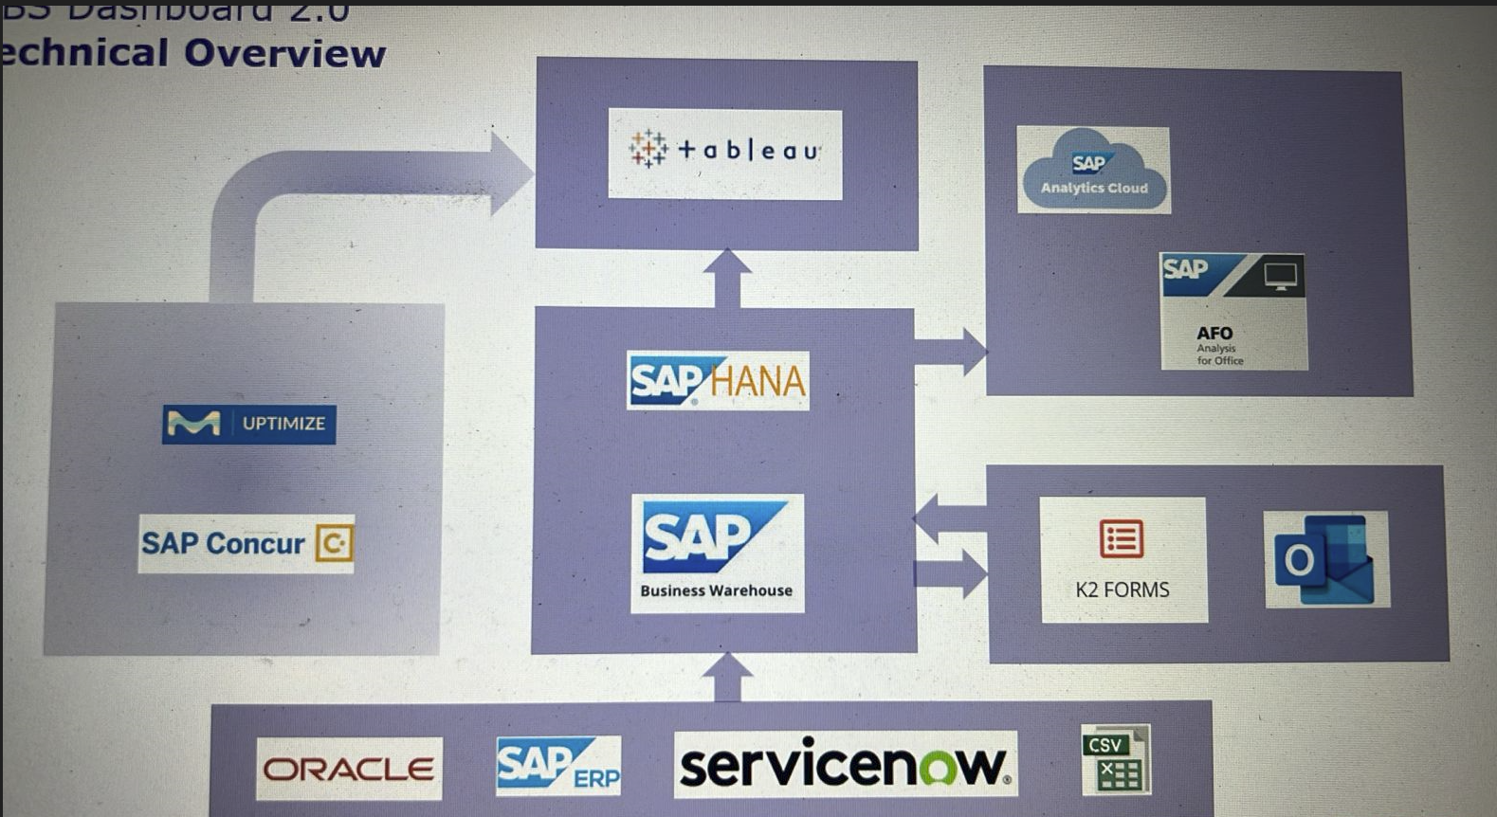
Project Architecture:

Slide 19
Brief Data Processing Procedures in Project
Data Cleaning:
Remove Duplicates: Identify and eliminate duplicate records.
Handle Missing Values: Fill in or remove null values based on data requirements.
Correct Data Types: Ensure that each field has the appropriate data type (e.g., integer, date, string).
Data Transformation:
Calculated Fields: Create new fields by applying formulas and functions to existing data.
Data Aggregation: Summarize data using aggregation functions (e.g., SUM, AVG, COUNT).
Filtering: Apply filters to exclude irrelevant or outlier data.
Grouping: Group data based on categories to facilitate aggregation and analysis.
Data Joining and Blending:
Joins: Combine data from multiple tables using join operations (e.g., inner join, left join).
Data Blending: Merge data from different sources without physically combining them, based on common fields.

Slide 20
Detailed Description of the Dashboard's Features and Functions
Features and Functions:
Filter: Dropdown Filters, Slider Filters and Search Filters:
Interactive Elements
Dashboard Actions: Filter Actions, Highlight Actions and URL Actions
Tooltips
Data Insights and Annotations : Summary Statistics, Annotations and Reference Lines
How to Use the Dashboard:
Filters: Use the filter options on the right-hand side to adjust the data displayed. Filters include date range selectors, drop-down menus for ticket status, and sliders for age ranges.
Interactivity: Click on chart segments to highlight related data across other visualizations. Use tooltips for more detailed information on hover.
Reset: A "Reset Filters" button allows you to clear all filters and return to the default view.

Slide 21
Charts Created
Comparing fund size and returns over different periods (
Comparing Expense Ratio and returns over different periods
Comparison of Fund size and Sub-Category
Sub-Category-wise Comparison of Fund Size and Expense Ratio
Creating a Risk Level Filter Parameter
Sum of Returns Based on Selected Return Period
Distribution of Mutual Fund Metrics by Risk Level
Different categories and sub-categories over rating
Distribution of funds by AMC name and category
Distribution of returns for different categories
Fund age years across different return period
Predicted Returns Over 7 Years and 9 Years
Min Sip across category

Slide 22
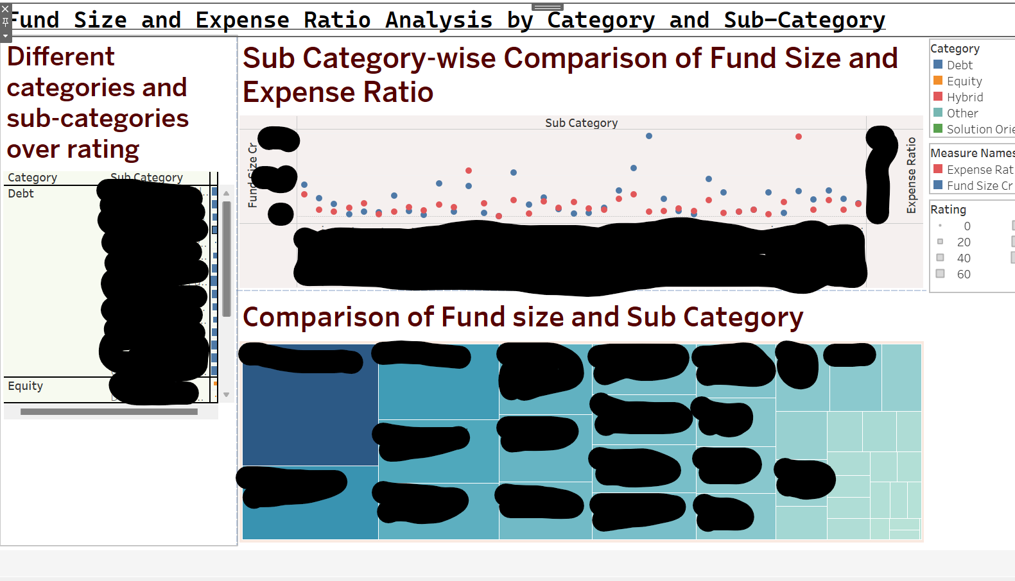
Dashboard Images-1:

Slide 23
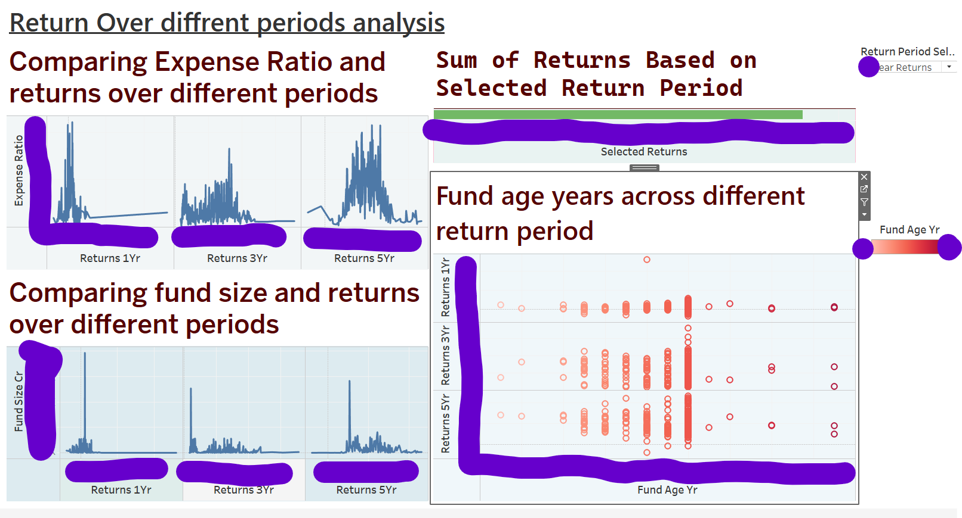
Dashboard Images-2:

Slide 24
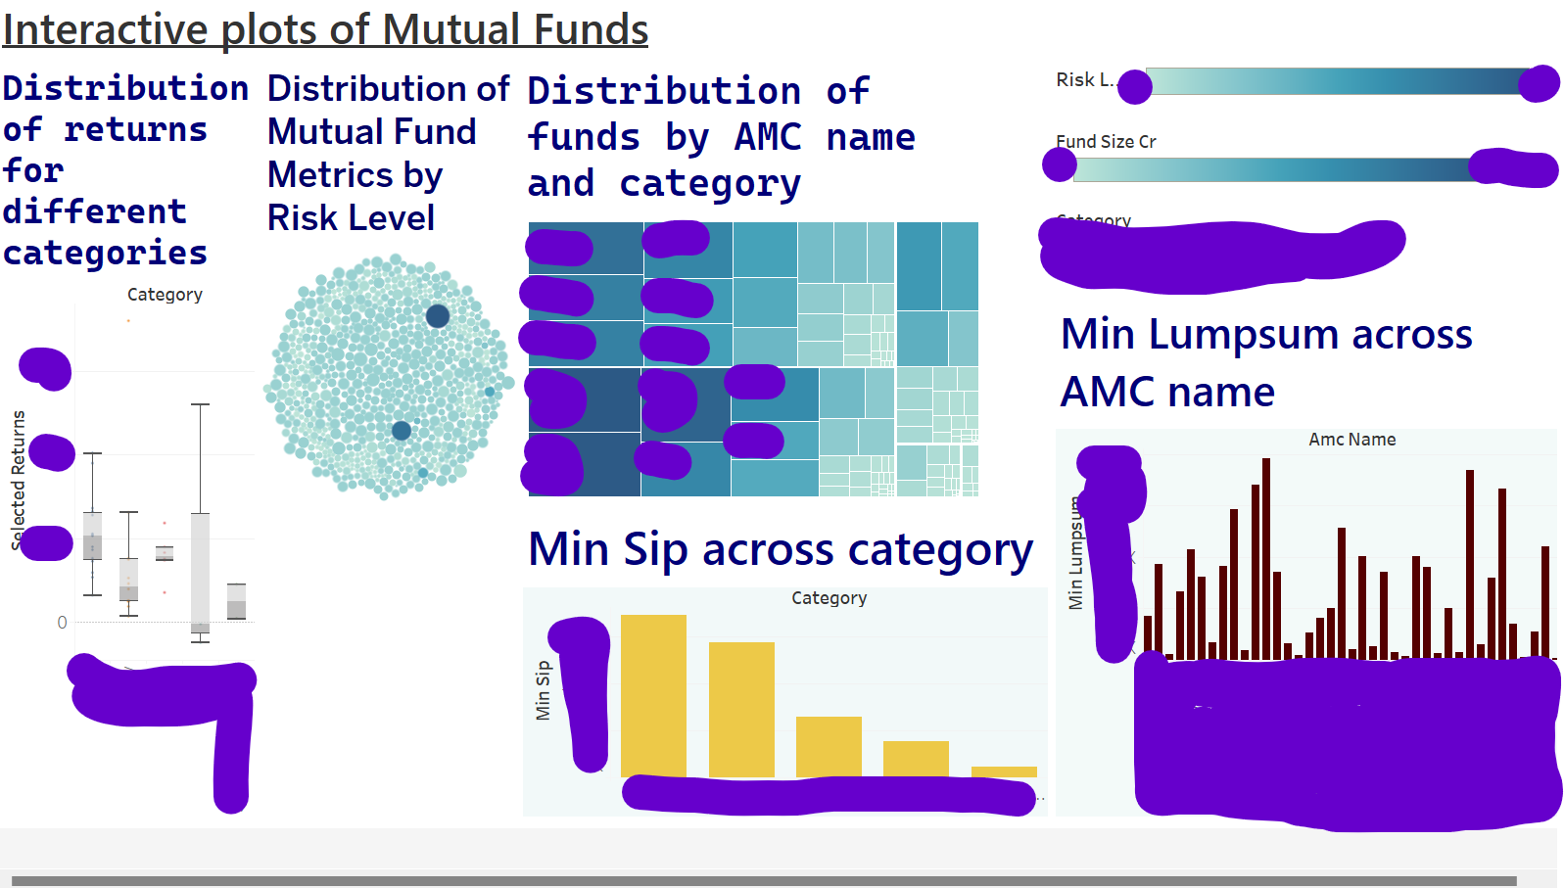
Dashboard Images-3:

Slide 25
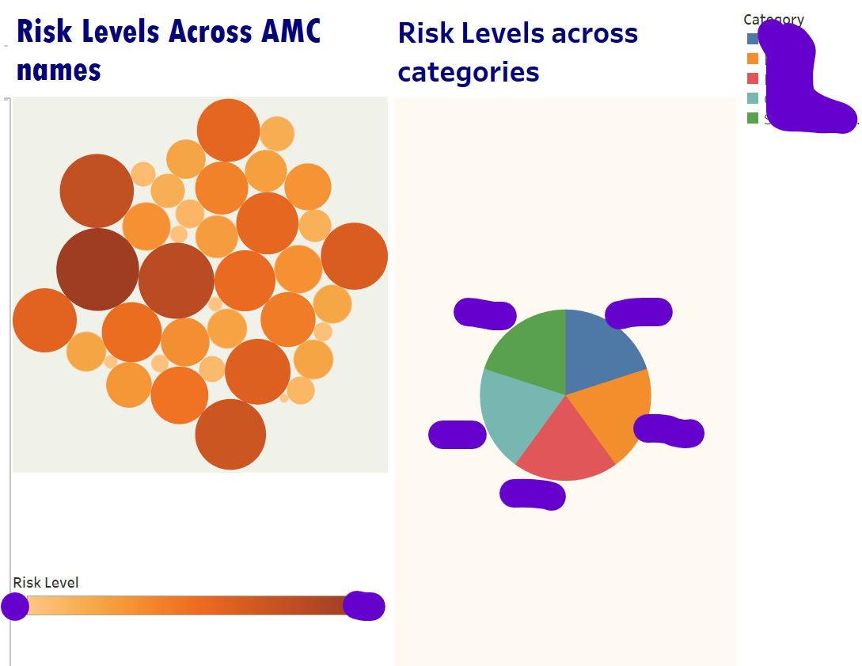
Dashboard Images-4:

Slide 26
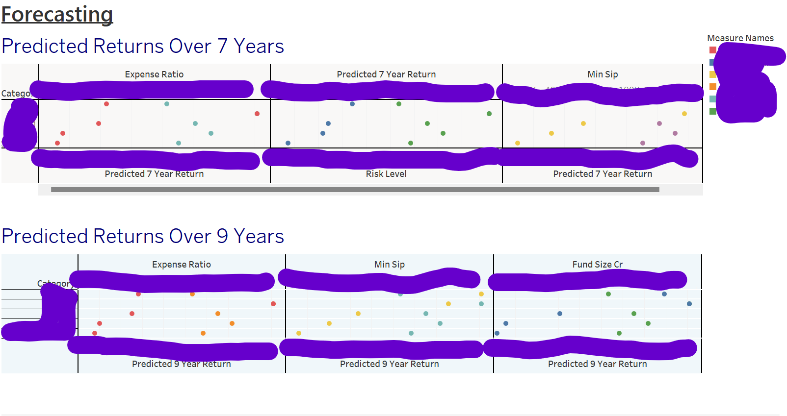
Dashboard Images-5:

Slide 27
Dashboard Solutions Customer Review
Dashboard Solutions Provided:
Performance Metrics
Performance Comparison
Growth Visualization
Asset Allocation
Top Holdings
Expense Ratios
Market Overview and Fund Trend
Investor Performance
Customer Feedback:
These features and Dashboard solutions provide a comprehensive view of mutual fund performance, investor behavior, market trends, and regulatory compliance, enabling users to make informed decisions and manage mutual fund investments effectively.

Slide 28
Ongoing Project-1
Predictive Marketing Campaign Dashboard: In this advanced Tableau project, we need to develop a comprehensive Predictive Marketing Campaign Dashboard using real-world data. We will leverage Tableau's powerful features and integrate Python for advanced analytics to track key performance indicators (KPIs) such as conversion rates, customer acquisition costs, and return on investment (ROI) across different marketing channels. By implementing machine learning models, we will also forecast future campaign performance and provide data-driven recommendations for strategy optimization. This hands-on experience will enhance your skills in data visualization, predictive analytics, and marketing analysis, equipping you with valuable insights for data-driven decision-making in marketing.
Tools and Technologies
Tableau Desktop
Python (for data preprocessing and machine learning)
TabPy (Tableau Python Server)
Machine learning libraries (scikit-learn)

Slide 29
Ongoing Project-2
Supply Chain Optimization Dashboard: In this advanced Tableau project, we need to create a comprehensive dashboard to optimize supply chain operations across procurement, production, and distribution stages. Using real-world supply chain data, we also apply advanced data visualization techniques and integrate Python-based predictive models to identify bottlenecks, forecast demand, and manage inventory levels effectively. This hands-on experience will enhance my skills in data analysis, predictive modeling, and dashboard creation, providing valuable insights for strategic supply chain management and decision-making.
Tools and Technologies
Tableau Desktop
Python (for predictive modeling)
Optimization algorithms
Data preprocessing and analysis techniques

Slide 30
Thank you
Venkat K
(945) 257 9379
Venkatesh.27@outlook.com
https://www.linkedin.com/in/venkat-k-13014821a/

